Slide 1
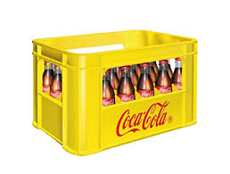
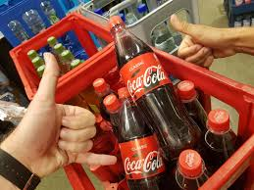
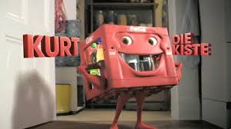
Returnables/ Refillables are a powerful tool to drive Category Leadership
Category Expansion!
Footprint: Incidence & Frequency
Affordability, Premiumness
Loyalty
Space: SOVI & Pantry
Sustainability
A one-of-a kind WIN-WIN-WIN-WIN System Proposition - WIN⁴

Slide 2
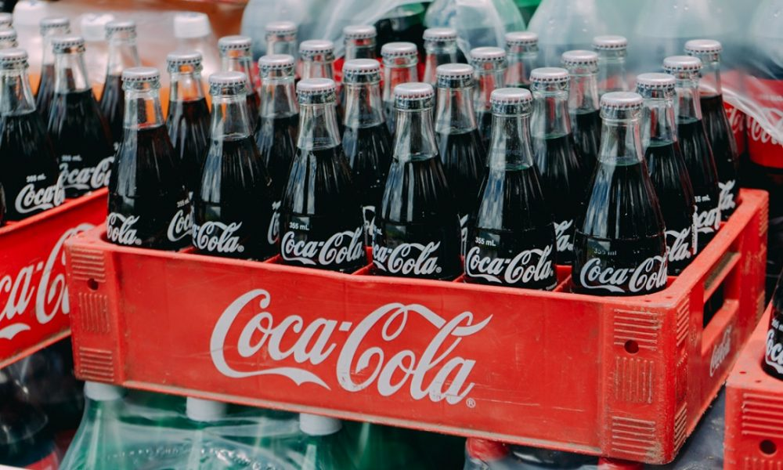
Agenda INSWA Returnables Summit
Global Vision
LATAM Affordability with Returnables
Arca Best Practice

Slide 3
The business imperative
The returnables platform is a key enabler for accelerated incidence and share growth while delivering our zero-waste goals.

Slide 4
Returnables play a strategic Role in our Business
COMPETITIVE ADVANTAGE
Protect our Base
CONSUMER PERCEPTION
Affordable and Competitive Price Points
Levers Habit and improves Frequency of Consumption
Key to consumer loyalty, as packages serve as a constant purchase reminder
CATEGORY EXPANSION
In periods of crisis, Returnables were more consistent as consumers are more loyal
Enables OBPPC Strategy Differentiating Packages – One Way
Returnables are key to PoS loyalty, not only bringing additional margin, but as an important tool to increase frequency
SUSTAINABILITY
Reutilize – World Without Waste

Slide 5
What is the mix of Returnable in each OU?
Returnables Volume Mix

Slide 6
Relationship between Disposable income and KO Percaps

Slide 7
Returnables have been one of the main growth drivers of the system, supporting KO to overcome recent crisis
Continuing to grow in Crisis
Returnables MS
Latam Volume
1.44 X
CAGR 3.7%
2020
9%
2021 YTD
7%

Slide 8
Yes…
…Returnables should be a Key Business Growth Pillar for our System…
…so, what should we do about it?

Slide 9
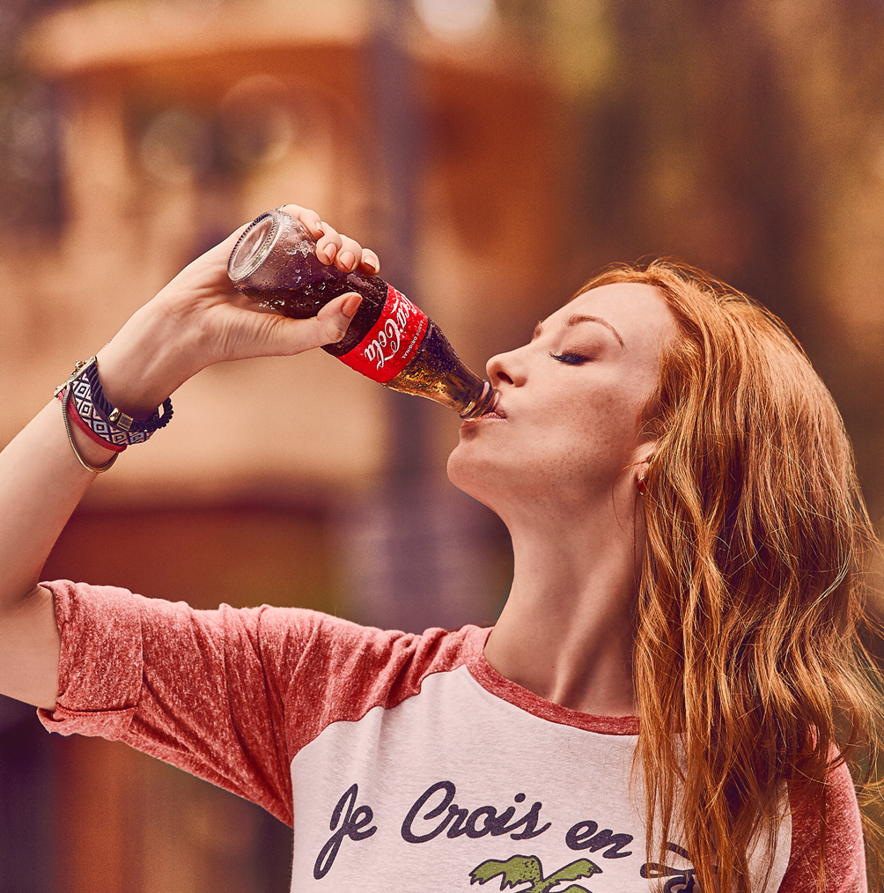
We should focus on our consumer Drivers
to turn them into our Returnability Edge
Powered by the brands´ Equity
Returnables’ EDGE
Affordability
Smart shopper
Best consumption experience
Better for the environment
“Iconic” experience
Relevance
Uniqueness
Returnables Edge is not only about the bottle
…but about the whole value proposition, powered by the Brand’s attributes and Equity, which makes it appealing and relevant to consumers.

Slide 10
Contributing in all relevant dimensions
in our 3 A’s model
Availability
Affordability
Affinity
Cold and ready to enjoy (drinking experience)
Competitive price
Best value equation
Smart shopper
Environmental care
Frequency enabler
Returnability!
Notes:
.

Slide 11
as a Subscription Model
Leveraging Returnability
It’s a Subscription Economy!

Slide 12
The Returnability virtuous cycle…
Winning
Portfolio
Holistic OBPPC (affordability + value)
Universal bottle
Full Engagement
Profitable
Consumer Base
Growth
Outstanding
Experience
BuilD & reinforce the returnable habit through fully integrated 360 Plans for all stakeholders
State of the art Execution
Appealing and call to action Communication
Consumer
Enablers, Processes, KPI´s & Continuous investment

Slide 13
Holistic OBPPC (affordability+value)
Universal bottle
Winning
Portfolio

Slide 14
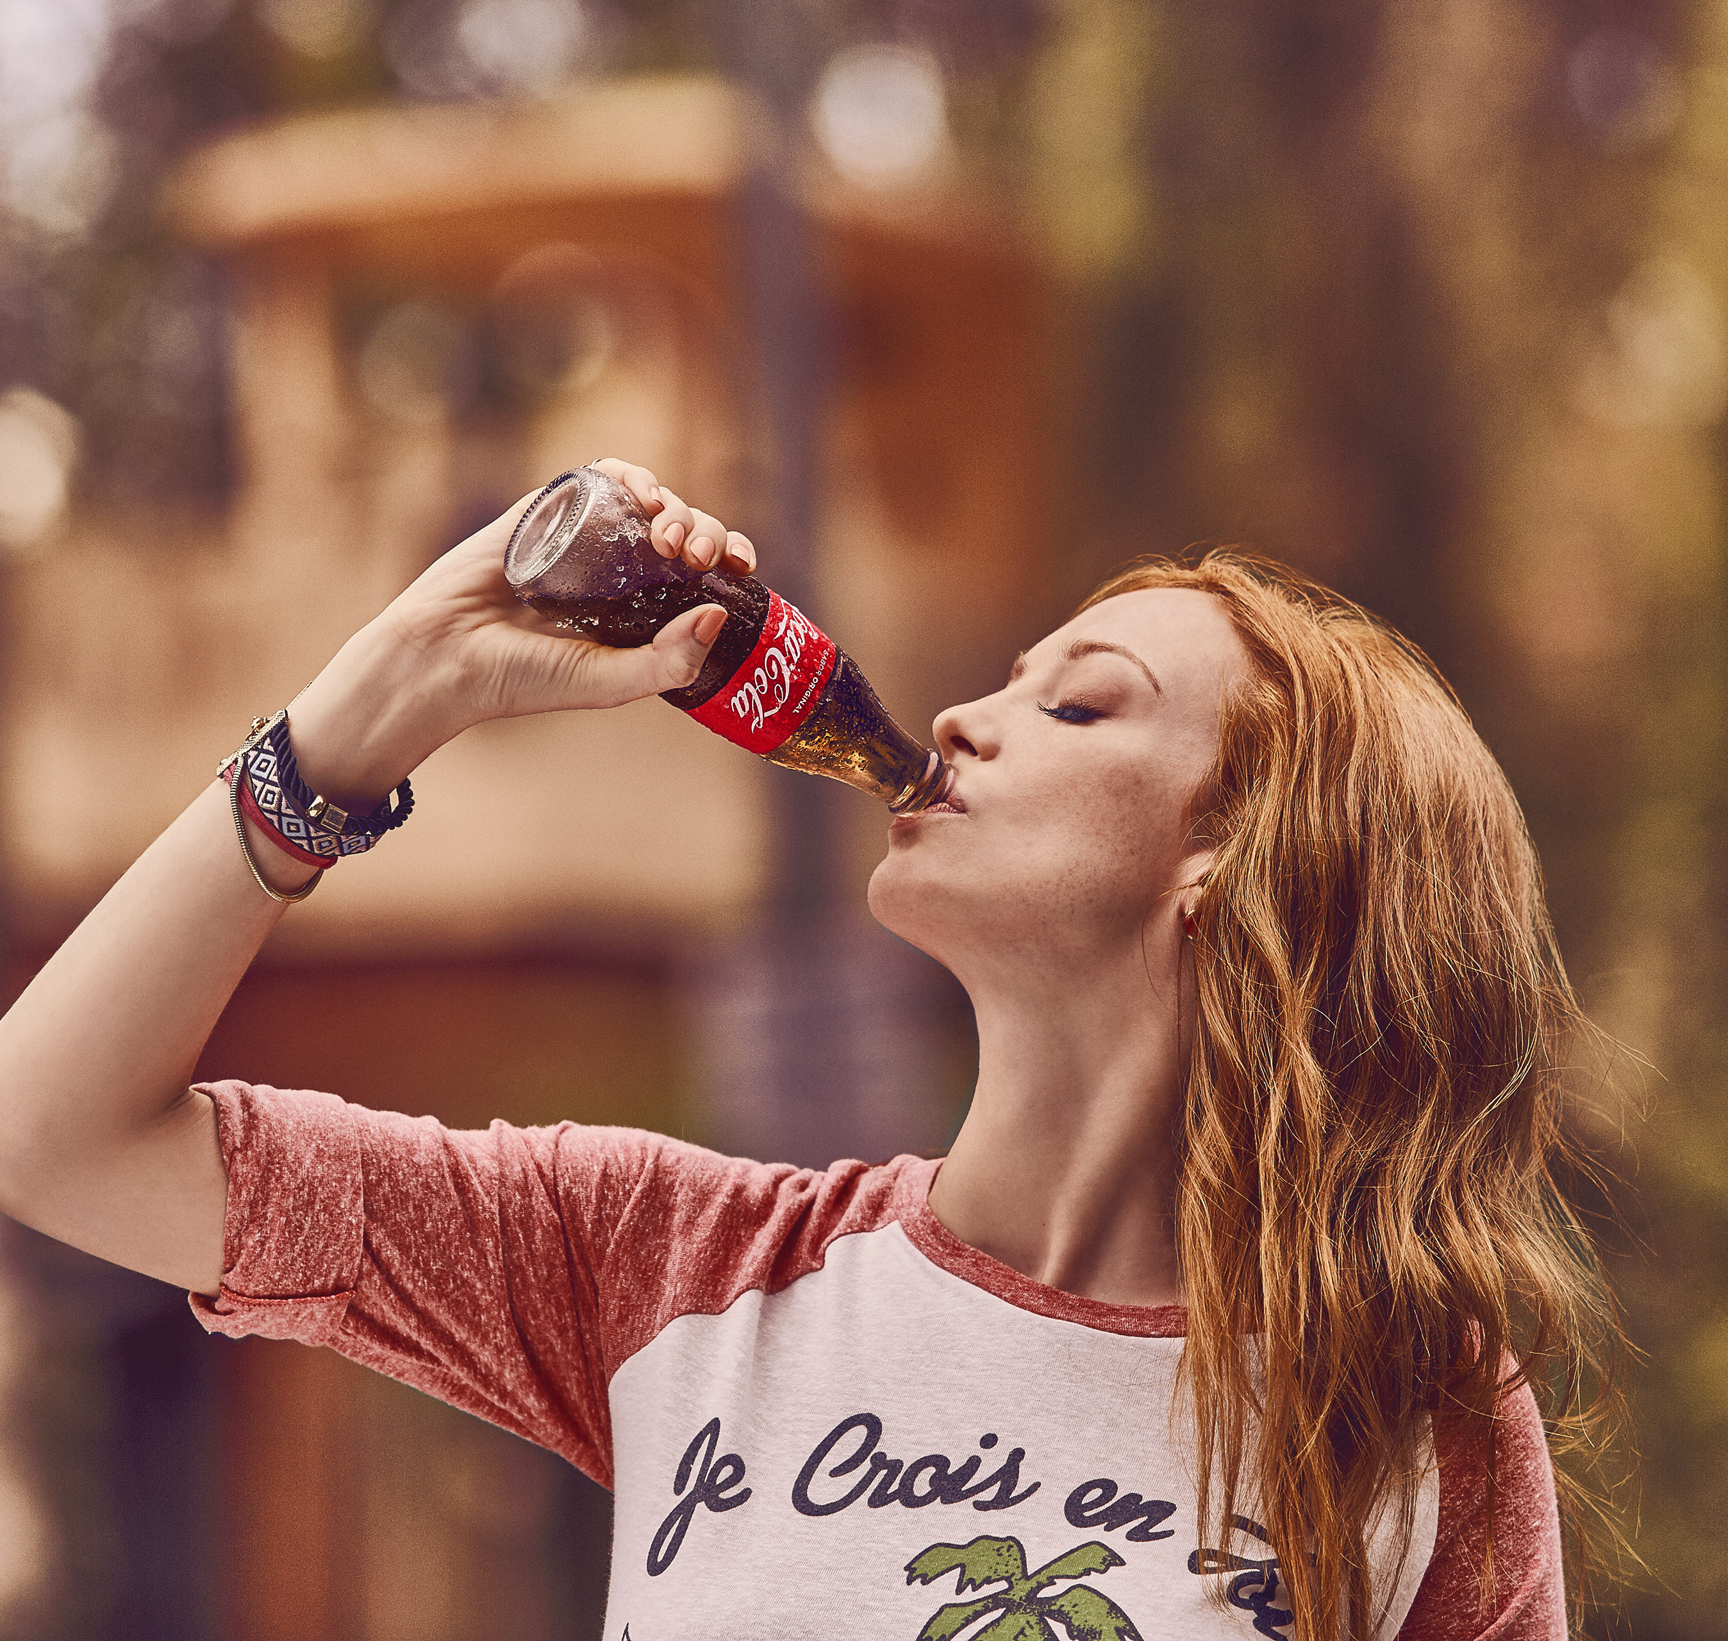
Returnables play a strategic role
in our Portfolio and Business
Returnables are the vehicle to ensure affordability and allow us to connect with low SEL
OBPPC strategy with a clear Returnables roles boost habit development by reaching more consumer & shopper needs
Segmented returnables allows to Maximize Revenue generation with one way packages
Glass Bottles with a premium role in IC Channels

Slide 15
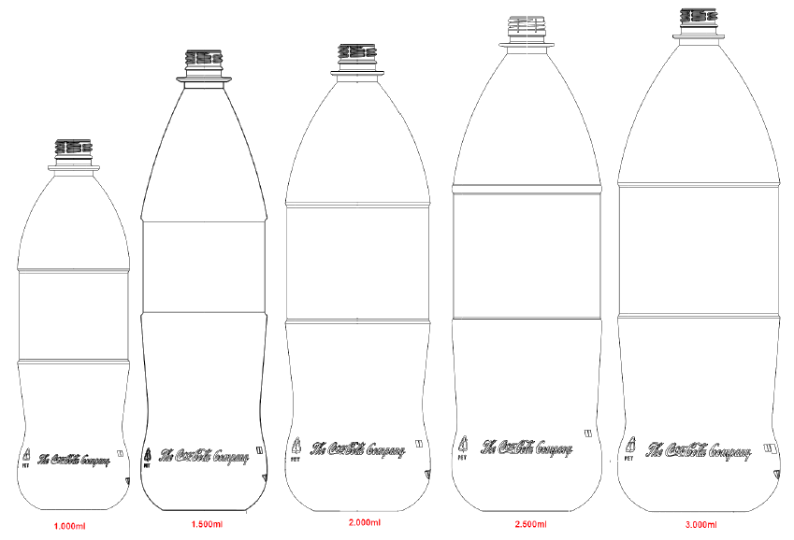
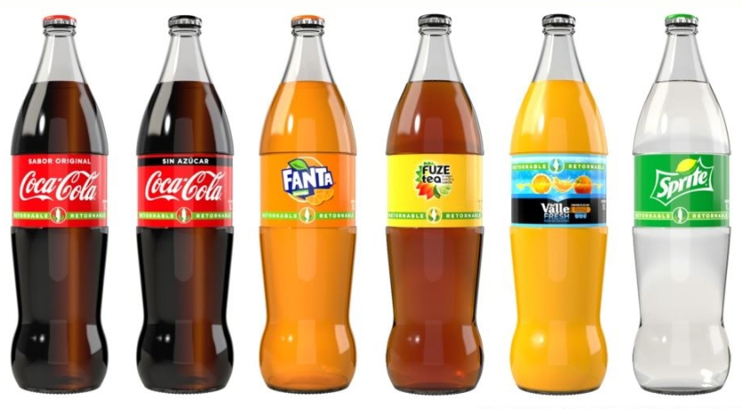
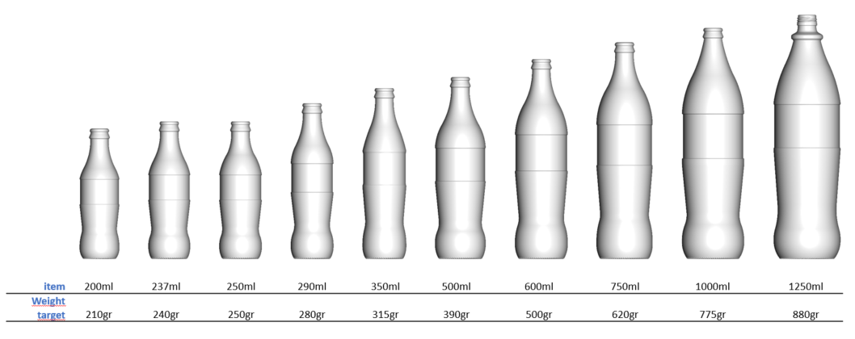
A new Returnable Bottle Family
Is ready to deploy
Ref Pet MS Universal Bottle
Contour without flutes
Fully Compatible with current fleet.
Lightweight 2L @ 91gr
KO Proprietary Technology (cost reduction)
RGB SS Universal Bottle
Cylindrical Panel with 3 contact points
Reduced scuffing
Aggressive lightweight
Enables labeling

Slide 16
State of the art Execution
Appealing and call to action Communication
Outstanding
Experience

Slide 17
Engaging consumer through
proper connection strategy
With the right
Messages
…and Right
Connection Points and moments

Slide 18
…will generate Returnable’s Execution EDGE
& improve our Quality Leadership
Availability
Improve profit - margins
Sales - Transactions
SOVI & SOCI
Volume
Revenue
Profit
Share of Market
Share of Value
CDE/10k hab
Items per store
Increase consumer base
Brand love
Dailies conversion
Per Caps increase
Better experience

Slide 19
Build & reinforce the returnable habit through fully integrated 360 Plans for all stakeholders
Full
Engagement

Slide 20
Engaging all players through
a full 360° returnable and affordability plan
Shoppers
Outstanding Communication and Promotional Platform for RET PicOS at POS
Retailers
Introducing a 4-tier plan:
Retailer Incentives
Loyalty programs
Visibility Drive
Training
360º
System Engagement
Motivating Sales & Distribution Teams
Sales force incentives
Distribution awards
Training
Tools
Trade MKT
Increase Transactions
Increase Profit

Slide 21
RGM – LATAM OU AFFORDABILITY

Slide 22
Affordability in Latam OU accounts for...
2,834
MM UC
213,008
MM USD
Xx
pp
Colocar dentro de SSDs cuanto es el aporte de share de retornables
VOLUME
REVENUE
SOV
36 %
# 6
65%
25 out of 39
MIX
PACKAGE ROLE
COUNTRIES

Slide 23
Affordability is one of our main bets
OW Profitability
Competitiveness
Sustainability
Cost Efficiency
Higher OW price points
Allows to enter in low income HH and increase frequency
Lower impact
Protect us vs law risk
Production and distribution cost efficiency due to scale up
MS Ref. generates:
LOYALTY
HIGHER FREQUENCY
INCREMENTAL VOLUME
(only 20-30% KO cannibalization)
+12pp
Source: Bain Study Brazil.
Source: Brazil, 2H ’20 vs PY, NSR Cube.
Notes:
POS that sells MS ref. outperform POS with MS OW only

Slide 24
Strategic Roadmap to Develop MS Refillables
Digital
Focus: Traditional Trade, Proximity.
S&H / C&C
4
Capture New Purchase
Dynamics
3
Provide Flavors/ Categories Choices
2
Expand Offer
Nepal with highest mix of RGB in INSWA (15%) should plan to move to stage 2 by launching MS RGB
1
Create the Habit
Combined Coverage
Notes:
This is our Strategic framework to drive this business.
1st we need to créate the habit launching focusing in one pack of the main Brand and the main pack role size (Pivot)
2nd and 3rd step Help us to increase frequency as we continue developing penetration.
2nd step is to increase the offer of that main Brand.
3rd expand other brands and categories.
And last expand to other purchase dynamics

Slide 25
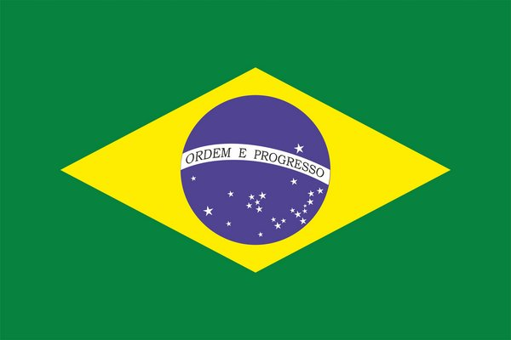
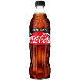
We have been growing this business for more than 10 years
ONE OF THE MAIN GROWTH DRIVERS OF THE SYSTEM, SUPPORTING KO TO OVERCOME RECENT CRISES
Returnable volume and margin growth
Continues to grow even with the crisis
3,4 Bi
2020:
3,4x NSR
+5%
Volume growth
1,8x Vol.
1 Bi
+1.3pp
Value share
+ 4MM
Contribution Inc. margin
9%
10%
7%
21%
16%
100%
222%
24%
76%
23%
Household penetration
GDP
9%
10%
7%
3%
0.5%
-3.5%
-3.3%
1.3%
1.3%
1.1%
Source: NSR

Slide 26
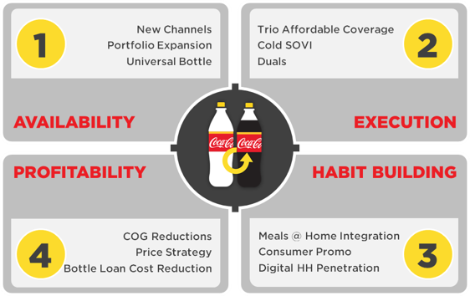
Returnables Strategic Framework
BOTTLE INVESTMENTS
Per Year
New PRODUCTION LINES
LABELLING MACHINES
ENABLERS
+
+

Slide 27
AVAILABILITY: Clear path to build a strong Returnable Package Culture

Slide 28
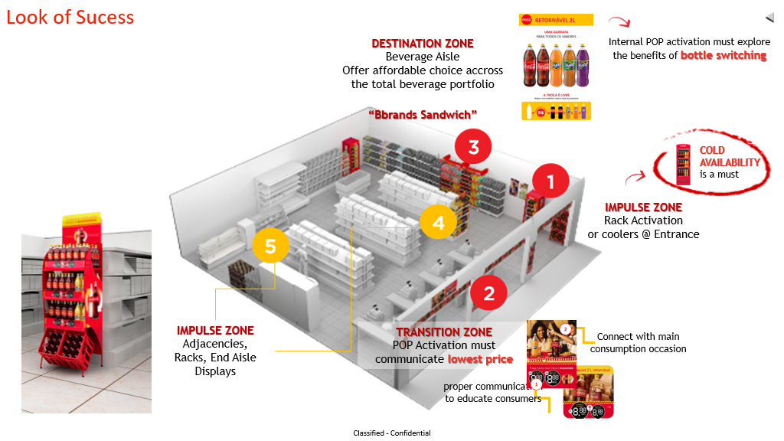
EXECUTION: Specific Look of Success for Returnables

Slide 29
HABIT BUILDING: Connect returnables with marketing campaing and launched national promotion

Slide 30
PROFITABILITY: Increase retunable profitability to gurantee sustainable growth

Slide 31
Moonshot Target
40% Mix → +6.4p.p vs 2020
Increase Household Penetration
SELECTIVELY PLAY
NEW OCCASIONS
Gain presence at breaks occasions and create the concept of affordability for single serve package
STAR
EXPANDING HABIT THROUGH A STRONG COMPETITIVE AFFORDABILITY PORTFOLIO
of sizes, brands (expand Flavors, No sugar and Juices) and prices.
Leverage Universal Bottler and have Segmented Communication.
19%
38%
DIGITAL CHANNEL
increase refillable presence through WABI and D2C verticals (Increasing Refillable mix 10pp in 5 years)
CHANNEL EXPANSION
modern trade is key to increase incidence and gain competitiveness
15%
28%
VIRTUAL BOTTLE
DIGITAL SEEDING
WWW Connection
PROFITABILITY

Slide 32
RETURNABLES SUMMIT
ARCA CONTINENTAL MÉXICO
DEC 2021
Notes:
Hello!!
My name is Karla Zamudio, I´m very happy to be here with you in this summit representing Arca Continental México, and for this presentation my co-worker Erick and I will talk a little bit of our experience and learnings with returnable packages, we hope you ´ll find them interesting and usefull for your teams. For us it´s been quite a journey and its our pleasure to share it with you.
And before I begin with the presentation I just want to thank you all for the invitation, it´s an honor for us to be here.

Slide 33
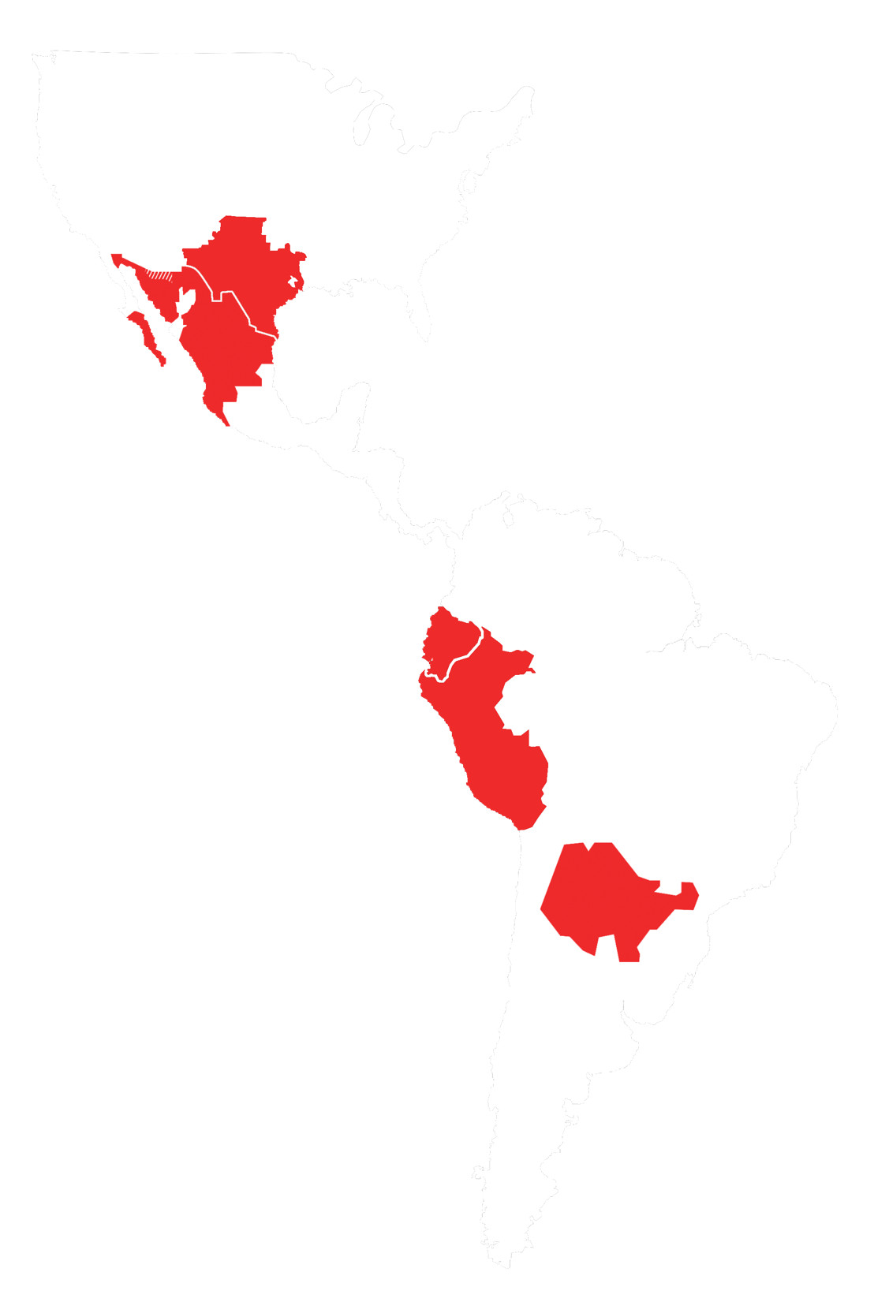
Serving 5 countries across the Americas
USA
MEXICO
Sales Volume
2020
Production Facilities
Associates
ECUADOR
2.2
169
46
379
62
+1.5
PERU
BUC
^{MXP$ billion}
^{thousand}
^{million}
ARGENTINA
Revenue
2020
Distribution Centers
Points of Sales
Notes:
K: Our operations are across 5 countries in America: USA, México, Ecuador, Perú and Argentina. With sales volume of 2.2 billion unit cases, 169 billion Mexican pesos of revenue as a comparing it with the dollar is more than 8.5 billion dollars.
We have 46 productions facilities and 379 distribution centers.
Also over 62 thousand associates, that are our more valuable asset
And more than 1.5 Million of points of sale.
A: We serve 5 countries across the Americas: Usa, Mexico, Ecuador, Perú and Argentina
With a sales volume of 2.2 billion unit cases
Almost 170 billon Mexican pesos of revenues (More than 8.5 Billion Dollars)
46 Production Facilities
379 distribution centers
Over 62 thousand associates, our most valuable asset
And more than 1.5 million points of sales

Slide 34
A balanced portfolio of markets and business…
REVENUES 2002 - 2020
ARGENTINA
ECUADOR
SNACKS
EXPORTS & VENDING
1%
PERU
USA
13x
CAGR
15%
2020
2002
MEXICO BEVERAGES 99%
MEXICO
MXP$ 13 billion
MXP$ 169 billion
Notes:
K: We have grown our business in a balanced way in the last 20 years. With a compound annual growth of 15%, going from being a company of 13 billion to almost 170 billion pesos. We used to have our revenue concentrated in Mexico, now we have presence in 5 countries in America and we hare expanding into other businesses such as snacks.
A:We have grown our business in a balanced way in the last 20 years With a CAGR of 15%, going from being a company of 13 billion to almost 170 billion pesos and having all our revenue concentrated in Mexico to having a presence in 5 countries and venturing into other businesses such as SNACKS

Slide 35
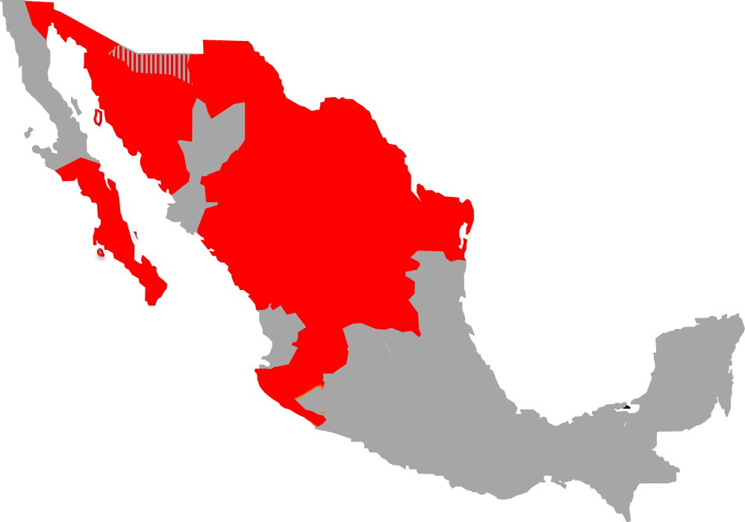
AC Mexico Overview
PACIFIC
NORTH
NORTH EAST
Sales Volume
2020
Production Facilities
WEST
Associates
968
62.8
20
116
34.5
553
MUC
W/JUG
MXP$ billion
W/JUG
^{thousand}
^{thousand}
34 Ret.
Lines
Revenue
2020
Distribution Centers
Points of Sales
Notes:
K: Talking about Mexico, we are divided in 4 regions, and our sales in 2020 were 968 million Unit cases (without jug) and over 62 Billion pesos in revenue. We have 20 productions facilities with 34 returnable lines, 116 distribution centers, more than 34 thousand associates and we serve over 550 thousand points of sale.
Now Erick is going to talk about the strategy of retournable packages in AC.
A:So, lets talk about México, the market we will be reviewing today
We are divided into 4 regionsour 2020 sales volume were 968 million unit cases without jug, over 62.8 billion pesos, with 20 production facilities in which we have 34 returnable lines, 116 distribution centers, more than 34 thousand associates and serving over 550 thousand Points of sales

Slide 36
Returnables are a relevant asset for our business
VOLUME
2020
MIX
PACKAGE
33
67%
33%
322
%
MS
MMUC
VS NARTD
SS
*MIX SHIFT DRIVEN BY COVID 19
(+6pp MS)
Notes:
Returnables have always been a relevant asset for our business in México, they represent a sales volume of 322 million unit cases, 33% of the mix of total NARTD and talking about packaging mix Multiserve has 67% and Single Serve 33%.
Its important to mention that due the COVID 19 Pandemic, we suffered a mix shift of nearly 6 percentual points from Single Serve to Multiserve, this was driven because of the loss off traffic at the On Premise and QSR’s Channels, of course, one of our main priorities for the years to come is to recover it.

Slide 37
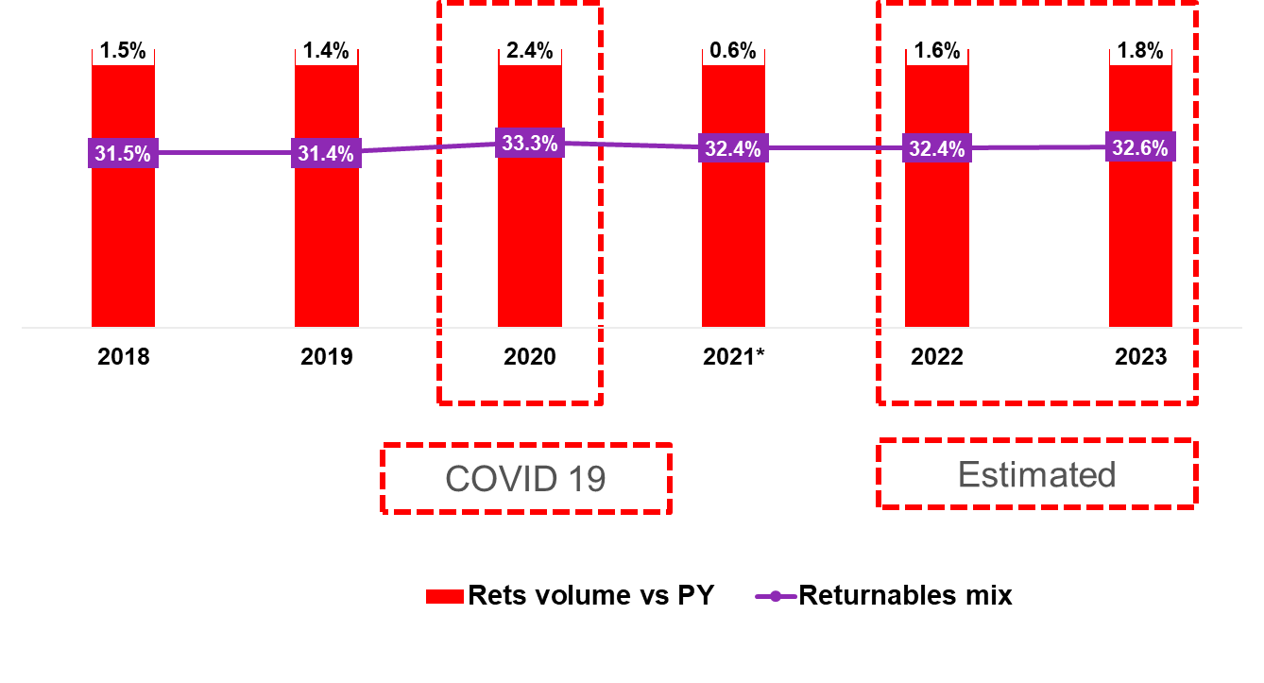
With a positive performance in the past years…
Notes:
In recent years we have had a good performance in the sales volume of our returnable packaging as an important basis to maintain our results last year, growing 2.4pp vs 2019 and gaining almost 2 points of mix, this was driven mainly by the traditional trade, wich represents over 60% of sales volume and gained relevance in the Pandemic, people were looking for more affordable options and the solid base of returnable that we built in the past years was up to this challenge.
Our strategy in the coming years is to continue betting on increasing the volume and mix of returnables.

Slide 38
Why are we betting on Returnables?
Consumer
Returnables are an affordable platform for consumers and generate the "smart purchase” proposal
They drive the purchase decision before arriving to the point of sale
Competitiveness
They generate a competitive advantage with a much more attractive price point (The best one)
Brand
They connect with the main consumption occasion: meals
They strengthen the perspective of a responsible brand that cares about offering options for the whole family and also take sustainable actions. (World Without Waste)
Notes:
But why we Will keep betting on Returnables?
Talking about the consumer:
They are an affordable platform for consumers and generate the "smart purchase” proposal
They drive the purchase decision before arriving to the point of sale, imagine that… at the time the consumer get the bottle in their hands, we are SURE they are going to buy our product… the real challenge for us it to have the right and COLD package at the point of sale
In terms of Competitiveness, they generate a competitive advantage, allowing us to have the best Price point for our Brands
They connect with the main consumption occasion Meals, we have an inside joke here at the coca-cola system in México, a real Mexican meal is no meal without a Coke, and if its returnable “the better”
They also strengthen the perspective of a responsible company with responsible brands, that care about offering options for the whole family and connect with the WWW Strategy we have as a system
And a bonus bullet for my fellow bottler partners, and it will be Profitability, for us the margin is bigger in returnable, betting on this packages allows us to keep a client base that is loyal and profitable.

Slide 39
Growth strategy based on 5 axis
Growth strategy based on 5 points
Consumer engagement
Competitiveness
(ROE)
Execution as a demand driver
Returnable Bottle Culture
Innovating and investing in the future
Operating with discipline and execution excellence
Notes:
Consumer engagement is the way we keep investing in media, assets, promotions and point of sale communication to connect with the consumer and clients and new tendeces.
We have certain Rules of engagement that to maintain competitive and profitable, i Will mention a few in the next slides
Thinking about execution not just as a “number” but a demand driver that in the end of the day help us to sell MORE, frontline force sales understand this and acknowledge that Returnable Packages drive traffic and sales increase when they are executed in the right way
In the past years we have focused on “taking care” of our returnable bottles, they represent a big investment into the market, this is why we share with the sales force, clients and consumers, selling stories and strategic dialogues so everyone understand the real value of this bottles, we have also developed materials we share with clients and consumer with tips and recommendations on how to take care of the bottles so they will last long
Always innovating and investing towards the future and based on our DNA “Operating with discipline and execution excellence”

Slide 40
The barriers and how we are facing them
BOTTLE AVAILABILITY
COLD
PRICE
Do they have the size that I want?
Is the product cold?
Is it the
right Price?
Returnable Purchase
Do they have the brand I am used to?
Do I have the time and tools to cool it down?
Can I integrate it to my budget?
Can I get another size?
Can I find it in another point of sale?
OW purchase or other brands
Yes
No
Fuente: INSITUM Entendimiento de los Retornables y Consumidor
Notes:
I was asked to talk about the barriers of selling returnable, so i decided to do it following this path to purchase algorithm that helped us understand and take action with a commercial approach, following this diagram I will share with you some simple but easy to implement strategies that we are doing today at Arca Continental
I want you to focus on the first 4 questions at the top of the diagram, the dynamic is easy, if the answer is YES they Will lead the consumer to BUY Returnables, if the answer is NO, we Will probably lost him or her and they Will end buying a One Way option if we are lucky, but the most probable thing that will happened is that they will find another brand

Slide 41
Do they have the right brand/size?
Notes:
What are we doing to solve this problem.
Bottle introduction is a MUST
We boost returnables with an aggressive bottle introduction each year to maintain the optimal inventory at the point of sale, and keep recruiting new consumers
A cultural change we did about 3 years ago it was to start selling the bottles we planned as introduction, with a target of selling at least 50% of the annual objective, this has helped us to maintain and increase the level of investment in a more efficient way
Another Good practice we are implementing, is visiting large mom and pops and doing a full store returnable activation to promote the use of returnables and recruting new consumer and continue to use Direct to home routes as a strategic pillar of bottle introduction
A new player in Arca Continental is the Universal Bottle, since last year we implement 2 lines in the Western Region, with a total sales volume of 2.2 MM UC in categories we didn't had in Returnables Multiserve such as Flavors, Fruit beverages and Coca-Cola Non Sugar, reaching above 35% coverage in target customers
And the latest member of the family, the 235 milliliters… with a magic Price point of $5 pesos in the launching months, this little guy has generated over 60 million transactions over the last 2 years in the western region and reaching 70% of coverage in target customers, a real recruiting booster
As you can see, an active and available portfolio at the point of sale is KEY.

Slide 42
Is the product cold?
Notes:
Is the product cold?
I want to keep this slide really simple… Racks and Coolers…
In México over 95% of the transactions at the point of sale are at the cooler, therefore we have over 270 thousand at traditional trade, maintaining a 55% of the fronts exclusively for returnable products.
The perfect company for the cooler are the Racks, we have the “Meals Rack” that is mainly focused on Returnable, we can have the right inventory close to the cooler to fill it up, in a visual spot. That's why we have over 170 thousand and 80% of coverage at the traditional trade and continue to invest in plataforms that help us to keep cold availability

Slide 43
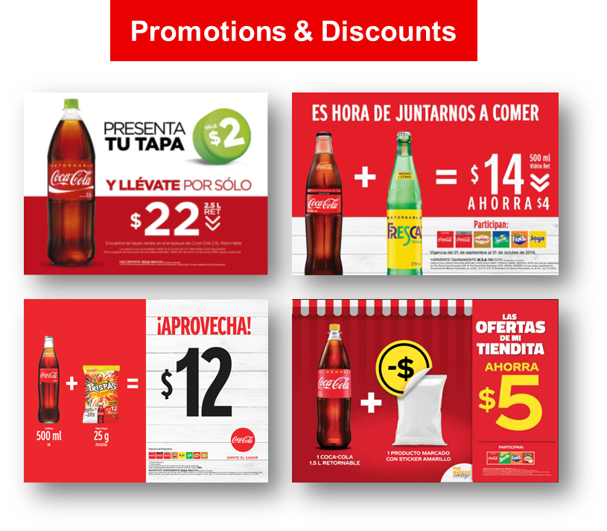
Is the price right?
Price Religion
PARITY
25%
P GAP vs
competitors NR’s
P GAP vs
our NR’s
Always ON / Segmented by region
Notes:
Let's talk about 2 Price religion keys for returnable in Mexico, one to maintain a parity Price with competitors and the other is to have a 25% of GAP with no returnables products.
And, to keep a Dynamic strategy of promotion and discounts, being aware of what the competitors are doing in terms of pricing and activating point of sale initiatives depending on the package, territory and Brand. As i have been telling, returnables are the main tool we have to fight against competition Price points therefore we keep evolving in terms of promotions. For sure we have direct discounts, but we also do joint strategies with snack brands and a good example is the basic goods sticker promotion we did last year, a year when people was looking for affordable options, the target was middle and low class and the dynamic was simple, buy a Returnable MS Bottle and a basic good marked with an exclusive sticker and they obtain a great combo price, simple? Yes, but for sure a main driver of our positive performance, and out clients, loved it.

Slide 44
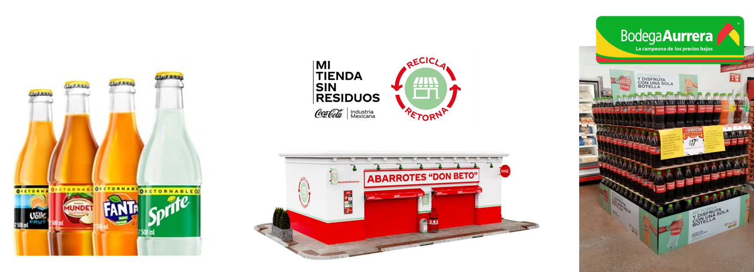
Thinking about the future, acting today
Universal Bottle Capabilities
12 lines in 2022 (SS + MS)
NCB’s Returnables
Campaign and promotion ready
World Without Waste
WWW Store Intervention
Communication Plan
Explore New Channels
Bodegas Deployment
Supermarkets Pilot
Notes:
This final slide shows: Whats next for returnables in ArcaContinental México?
We Will continue investing in new línes of universal bottle 12 launching ss and ms products, and new catagorys like juice or wáter and taking advantage of the label to do promotions and relevant communication
World Without Waste Will be one of the main pillars of the new returnables communication plan, for the next year we are looking forward to transform over 300 stores with this bold message and a strong investment on media
And exploring new channels, such as “BODEGAS” that is the Walmart proposition of low Price point here in México and to keep cracking the code to be in Supermarkets.

Slide 45
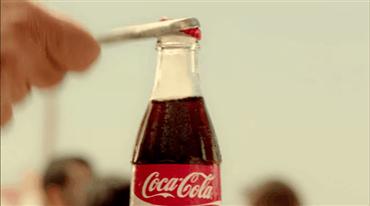
Let´s expand our Returnables footprint around the world!
We wish all the very best to
Sri Lanka team for launch of MS RGB and Bangladesh Team for launch of 175 RGB next year.
Also looking forward to scale-up of 175 RGB across all of Nepal.
Notes:
We Will continue investing in new línes of universal bottle 12 launching ss and ms products, and new catagorys like juice or wáter and taking advantage of the label to do promotions and relevant communication
World Without Waste Will be one of the main pillars of the new returnables communication plan, for the next year we are looking forward to transform over 300 stores with this bold message and a strong investment on media
And exploring new channels, such as “BODEGAS” that is the Walmart proposition of low Price point here in México and to keep cracking the code to be in Supermarkets.

